Slide 1
Supplying the critical industry’s
AEU00134 ISS 01

Slide 2
Understanding the requirements of our customers can be difficult.
We have always been encouraged to look for better, quicker, more efficient and easier ways of working.
With certain customers work we are not allowed to change or even improve unless the customer agrees
In some cases, we can’t even change the colour of the pen we use to sign documents.
The aim of this presentation is to explain why we ask our team to work in ways that are controlled to a degree that can seem illogical, even ridiculous.

Slide 3
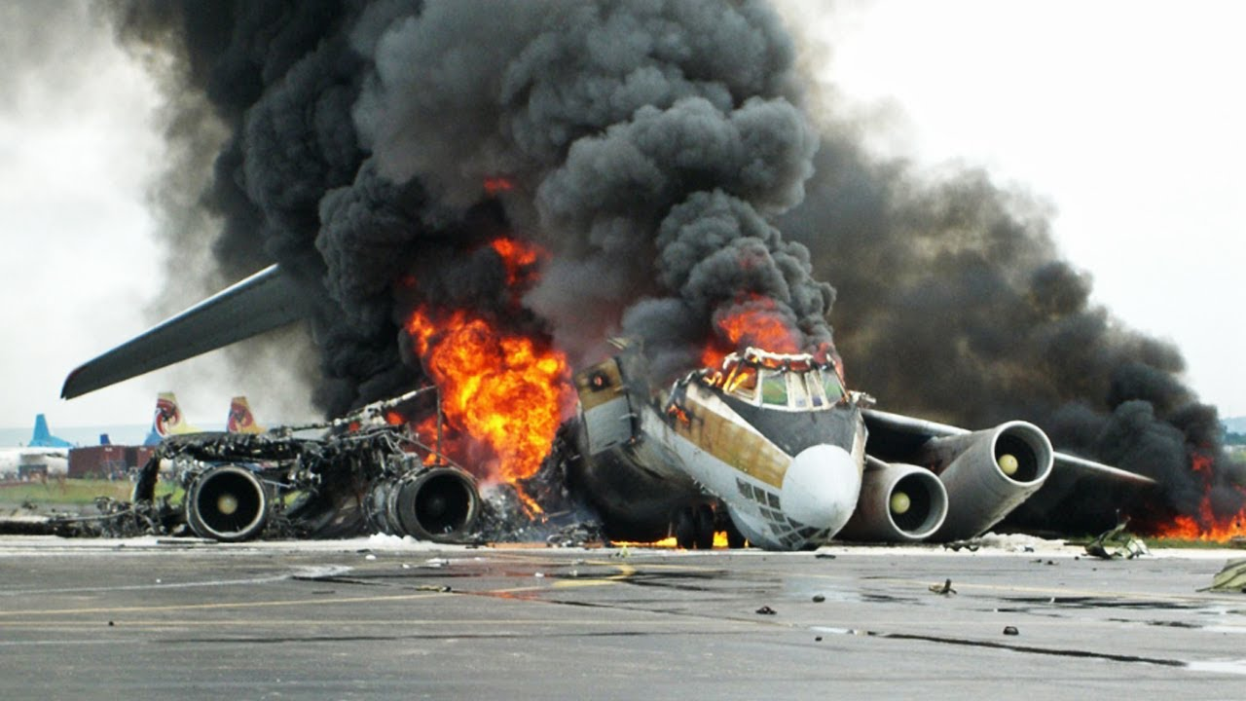
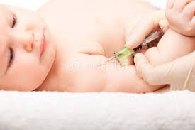
Safety
We produce and supply parts to the most demanding
industries in the world.
.
Every time a drug is inhaled , a car has to brake, a plane has to land, it has to work and be safe.
Quite literally peoples lives depend upon it.
Any failure could be catastrophic
User safety has to be the number 1 priority

Slide 4
Checking parts is often a destructive test and so the actual parts used can not be tested.
Q. How do we make sure that the parts that are not tested will work and are safe?
A. We validate the process used to produce them
and make sure that everything thereafter is made in
EXACTLY the same way.

Slide 5
Albert Einstein defined insanity as ‘Doing the same thing over and over again and expecting different results’
The principles of the critical sectors seem to agree…
If you process EXACTLY the same things, in EXACTLY the same way, over and over again, the output will always be EXACTLY the same.
This is how company’s in safety critical sectors control their
development and manufacture processes.
They expect and demand that their suppliers apply
the same philosophy and controls to their products.
This is achieved through cGMP

Slide 6
cGMP
WHAT IS cGMP?
cGMP= Current Good Manufacturing Practices
Best practices used globally in medical manufacturing to ensure product quality….
At this time
GMP was developed by the pharmaceutical industry. At AEU we aim to use the principles of GMP for everything

Slide 7
The validation Process
DEFINING THE REQUIREMENTS OF THE PROCESS.
A document called a User Requirement Specification (URS) is developed and approved.
The URS defines what the customer needs from the process.
The URS is used as the terms of reference for the whole project. The end result must meet the URS.

Slide 8
The validation Process
PLANNING THE VALIDATION OF THE PROCESS.
A document called a Validation Master Plan (VMP) or Validation Plan (VP), is created and approved .
A Validation Master Plan (VMP) is normally used to plan the validation of a project. A Validation Plan (VP), is normally used to plan the validation of a specific process.
They define what testing will be performed during validation to ensure that the requirements of the URS are met.

Slide 9
The validation Process
THE VALIDATION PROCESS.
There are four stages of testing that should be considered when creating the plan. These are called Qualification stages
For purchased equipment, off site and onsite testing may be included
For purchased equipment testing at the suppliers site, Factory Acceptance Testing (FAT), is performed
Not all of the stages may be required to prove all processes.
If you decide not to include all of the stages, you should provide a rationale as to why in the validation plan.

Slide 10
The validation Process
THE FOUR STAGES OF ON-SITE VALIDATION OF A PROCESS.
Design Qualification (DQ) – static testing to verify that the design meets the URS
Installation Qualification (IQ) – static testing to verify that the installation is as designed
Operational Qualification (OQ) – dynamic testing to verify that the equipments safety and quality critical features work correctly
Performance Qualification (PQ) – dynamic testing to verify long term performance
Test protocols are raised to define and record the tests being carried out at each stage

Slide 11
Documentation
Documentation proves that we have followed our validated processes
It shows we know what we did, when we did it, who it was done by and why it was done
It allows traceability of every decision taken, every action carried out and every product produced
It is a critical part of cGMP
‘If it’s not written down it’s a rumour….If it’s not signed and dated it’s graffiti’ A quote from an FDA auditor

Slide 12
Change Control
Once validated, a process CAN NOT be changed without being re-validated and approved.
Any change MUST be assessed to identify any associated risks
The level of validation depends upon these risks
Appropriate, stringent change controls MUST be applied.
Customer approval MUST be given or a rationale as to why not, provided. This includes ANY changes to: equipment, re-location, documentation, material, chemicals, processing conditions, labelling, suppliers.
Once a process has been validated it is very expensive to re-validate.
There must be very good reason for a customer to consider allowing a change to be made.

Slide 13
Golden rules of cGMP
Processes MUST be validated and NOT changed without authorisation
ALWAYS follow procedures & instructions EXACTLY!
Do NOT carry out a task for which you do not feel competent
All actions MUST be documented!
Everything documented MUST be signed and dated!
ALWAYS use the dd/mmm/yy or dd/mmm/yyyy date format!
Changes to paperwork MUST not obliterate the original information.
The reasons for any such changes MUST be clear or explained!
Always be on the look out for mistakes, defects, changes or unusual events and report them immediately.
Do NOT allow eating, drinking, smoking or personal medication in the manufacturing areas!
NEVER guess - If in doubt ASK!

Slide 14
cGMP is simple
Summary
Find a way of achieving what is required.
Define it
Sustain it

Slide 15
When we are making, testing, packing what might appear to be insignificant parts, remember…….
Summary
We are all patients.
We are all passengers
Most of us drive
Our own safety depends on cGMP

Slide 16
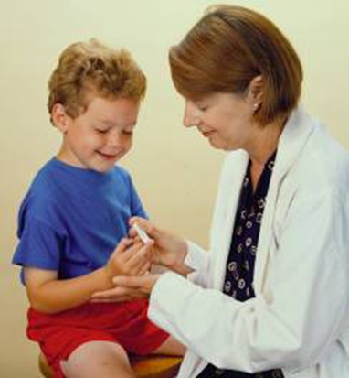
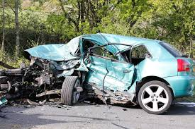
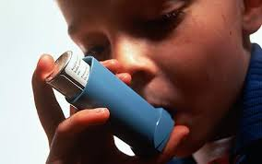
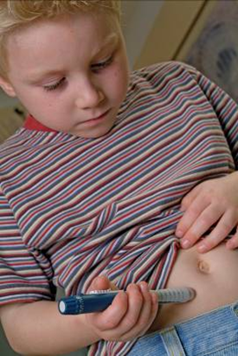
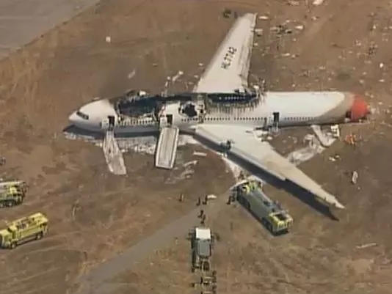
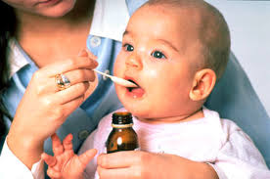
GMP
Summary
IT’S NOT AN AIM
IT’S A PROMISE

